Slide 1
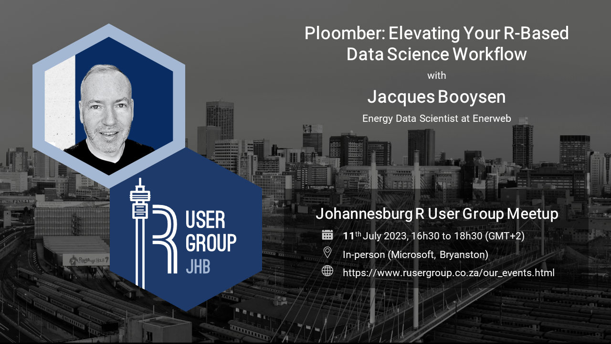

Slide 2
Add R support to Ploomber/Soorgeon Hack session
Details
Are you passionate about data pipelines, workflow management, and the R programming language? Join us for an exciting and collaborative hack session as we add R Support to Soorgeon!
Date: 21 July 2023 (Today!) Time: 13h00 (GMT+2) Location: Click here to join the meeting Repo we'll be working in: https://github.com/booysej/soorgeon
About Soorgeon: Converts monolithic Jupyter notebooks 📙 into maintainable Ploomber pipelines. 📊 What to Expect: During this hack session, we'll come together as a community of R aficionados, and workflow enthusiasts to tackle the challenge of incorporating R support into Soorgeon. Whether you're a seasoned R developer or a workflow management enthusiast eager to contribute, this event is for you!

Slide 3
Add R support to Ploomber/Soorgeon Hack session
Introduction to Soorgeon: Get an overview of Soorgeon.
Identifying R Integration Points: Collaboratively brainstorm and identify key areas where R support can be seamlessly integrated within Ploomber and Soorgeon.
Hands-on Coding: Split into teams or work individually to code and experiment with R integration. Share ideas, exchange knowledge, and collaborate to overcome challenges.
Group Discussions and Demos: Reassemble to discuss progress, share experiences, and showcase your achievements. Learn from others and gain insights into different approaches to tackle the integration.
Contributions and Next Steps: Learn how to contribute your work to the Ploomber and Soorgeon projects and discuss the roadmap for future R-related enhancements.

Slide 4
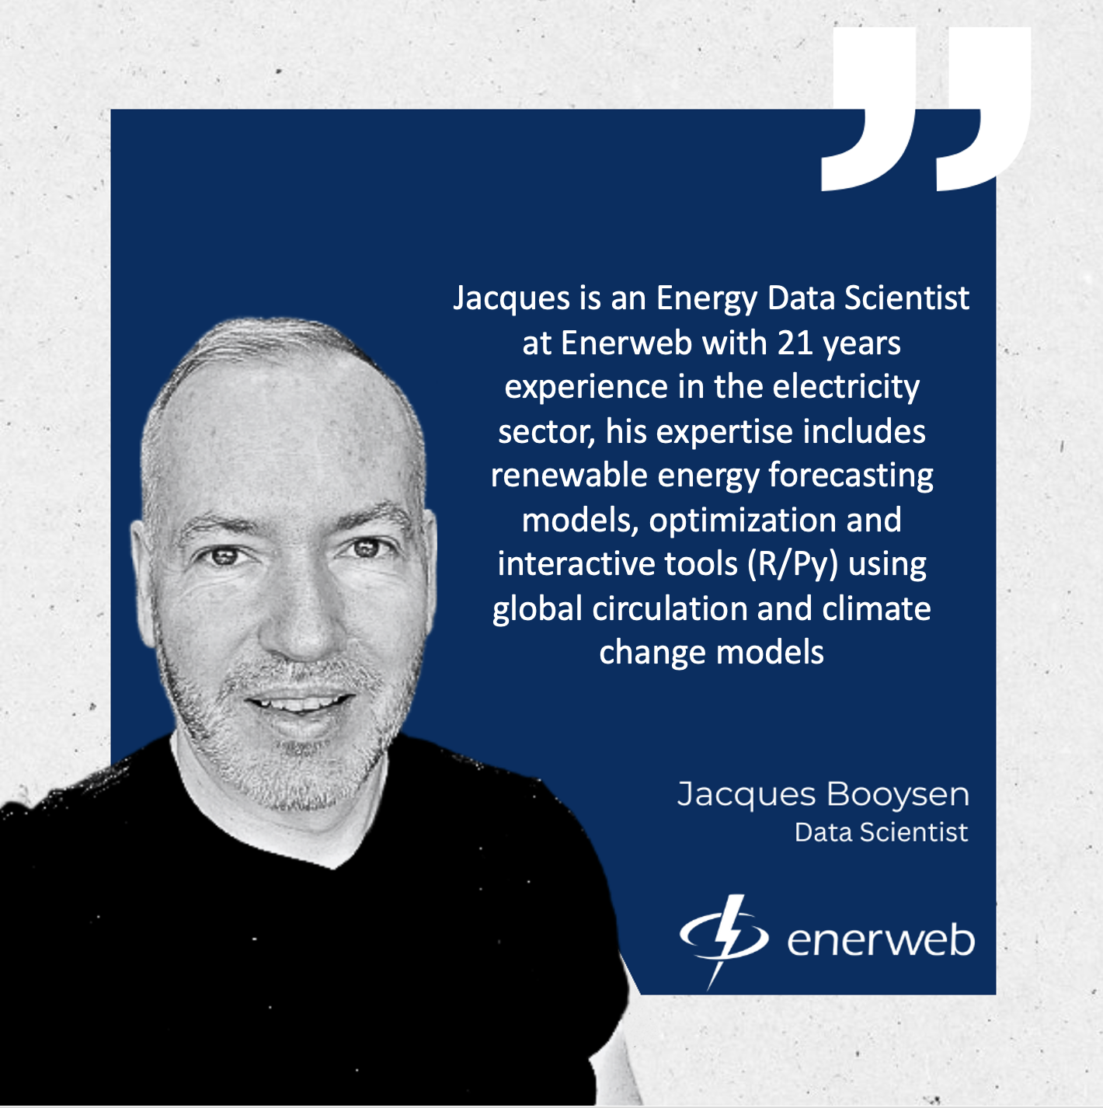
About me
I have a passion and love for:
Mountain Sport, Volcanos and Outdoor Adventure
Proud husband and dad of 2 little ones 5 and 2, they outsmart me all the time.
Data Science, the Electricity Sector and Load Research

Slide 5

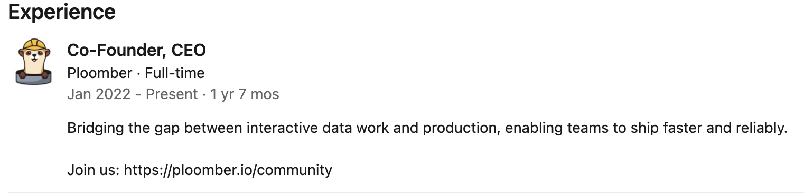
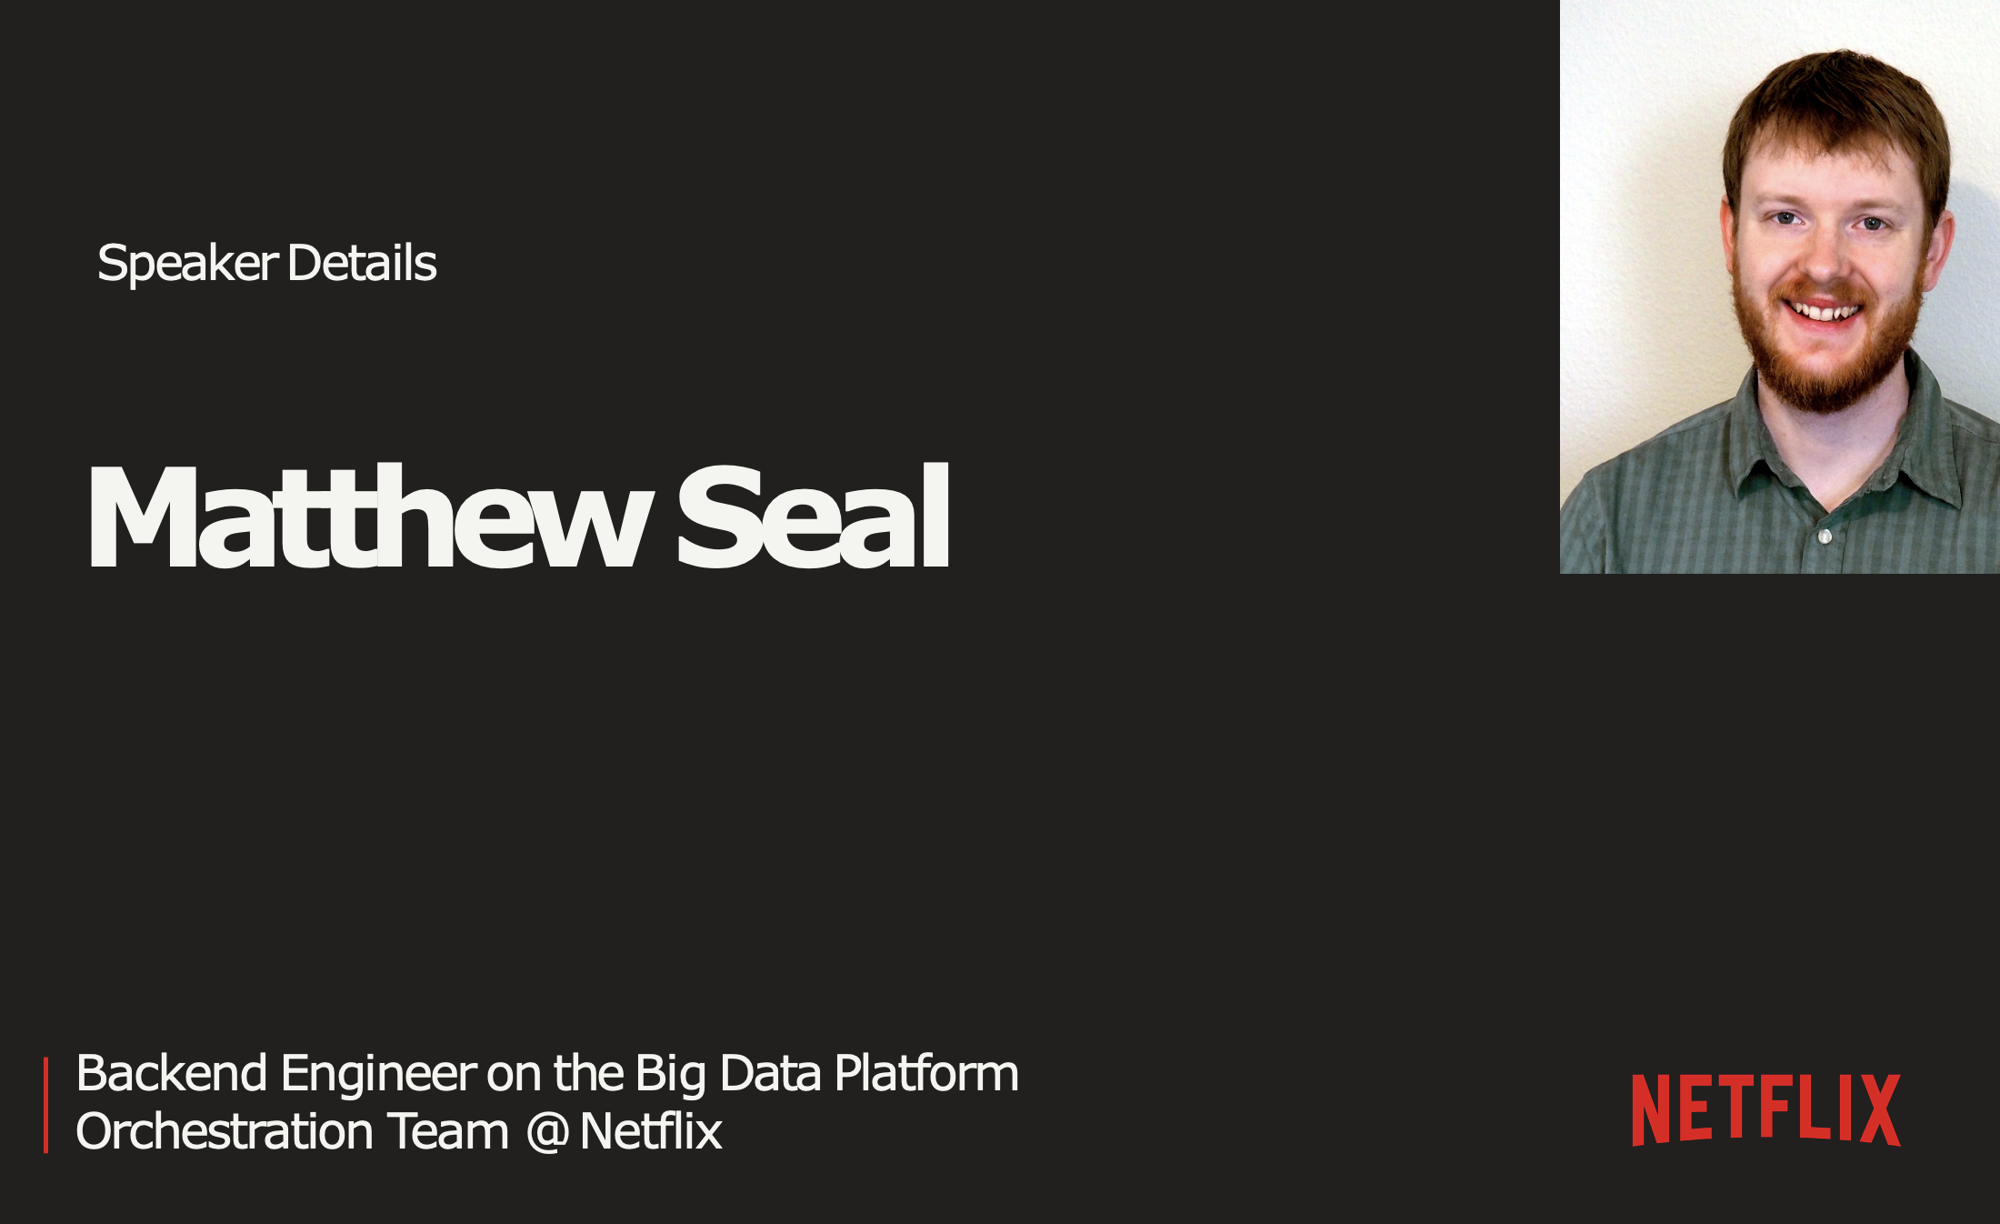
Credits / References
Note: I am no expert at Ploomber, I recently started using it and started exploring the R support and will share it in this presentation.
I must give credits as I reused some slides from:
Eduardo Blancas- Streamline your Data Science projects with Ploomber | JupyterCon 2020
Eduardo Blancas Ploomber CEO and founder
Notebooks as Functions with Matthew Seal (Netflix)

Slide 6

Data Science is all about experimentation
•
Three stages for each experiment:
Thinking
Coding
Execution
More experiments = higher chance of
success
•

Slide 7




Exploring and Prototyping.
Notebook
explore
Data Scientist
analyze

Slide 8
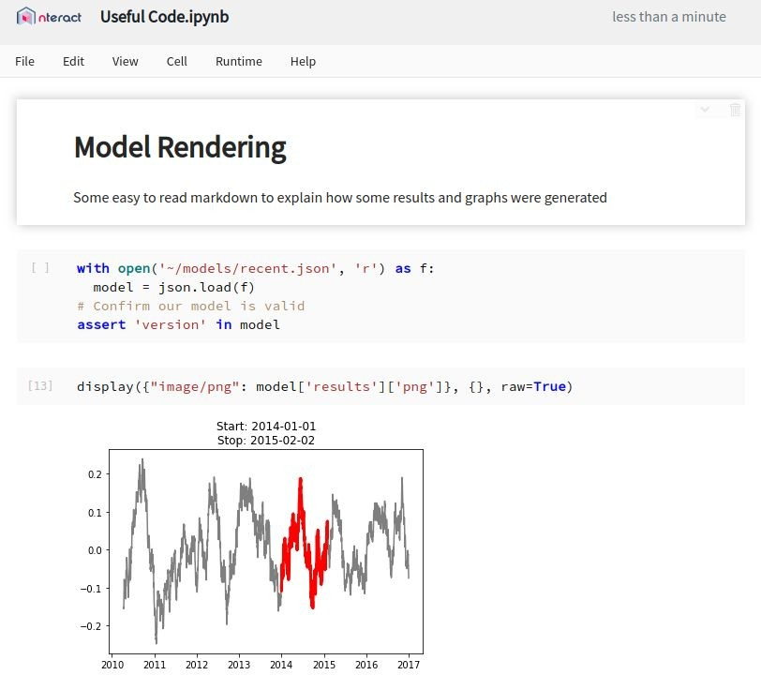

Notebooks.
A rendered REPL (Read-Eval-Print Loop) combining
Code
Logs
Documentation
Execution Results.
Useful for
Iterative Development
Sharing Results
Integrating Various API Calls

Slide 9

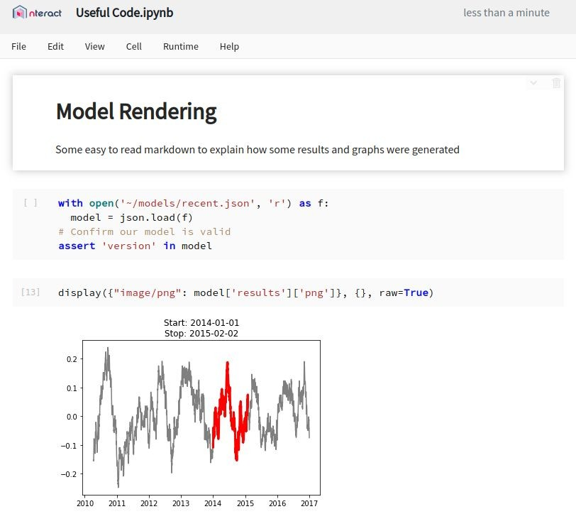

A Breakdown
Status / Save Indicator
Code Cell
Displayed Output

Slide 10
Wins.
Shareable
R Python and more Kernels
Easy to Read
Documentation with Code
Outputs as Reports
Familiar Interface
VSCode extention
Multi-Language

Slide 11
The Good.
Notebooks have several attractive attributes that lend themselves to development stories:
Quick iteration cycles
Expensive queries once
Recorded outputs
Easy to modify

Slide 12


Notebooks: A REPL (Read-Eval-Print Loop) Protocol + User Interface
Jupyter
UIs
develop
execute code
receive outputs
share
save / load
.ipynb
Jupyter Server
forward requests
Jupyter Kernel
R / Python / etc.
It’s more complex than this in reality

Slide 13
The Bad.
But they have drawbacks, some of which kept Notebooks from being used in wider development stories:
Lack of history
Difficult to test
Mutable document
Hard to parameterize
Live collaboration

Slide 14

Filling the Gaps

Slide 15



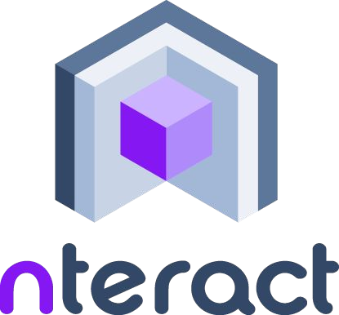

Open Source Projects
Contributed to by
https://github.com/nteract/nteract

Slide 16


A simple library for executing Notebooks with parameters
s3://output/mseal/
S3
EFS
parameterize & run
input
Papermill
store
run_1.ipynb
run_2.ipynb
template.ipynb
input notebook
run_3.ipynb run_4.ipynb
output notebooks

Slide 17
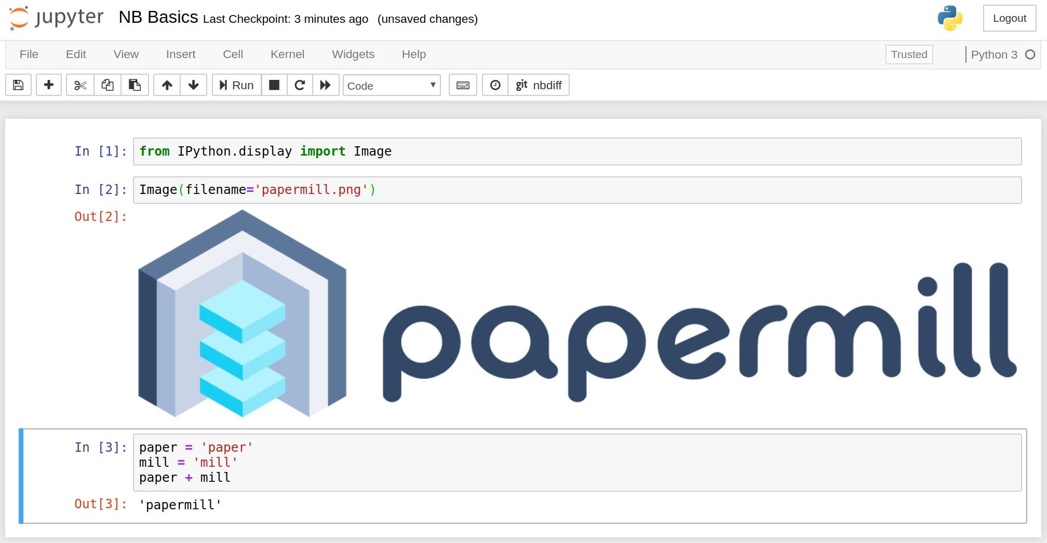
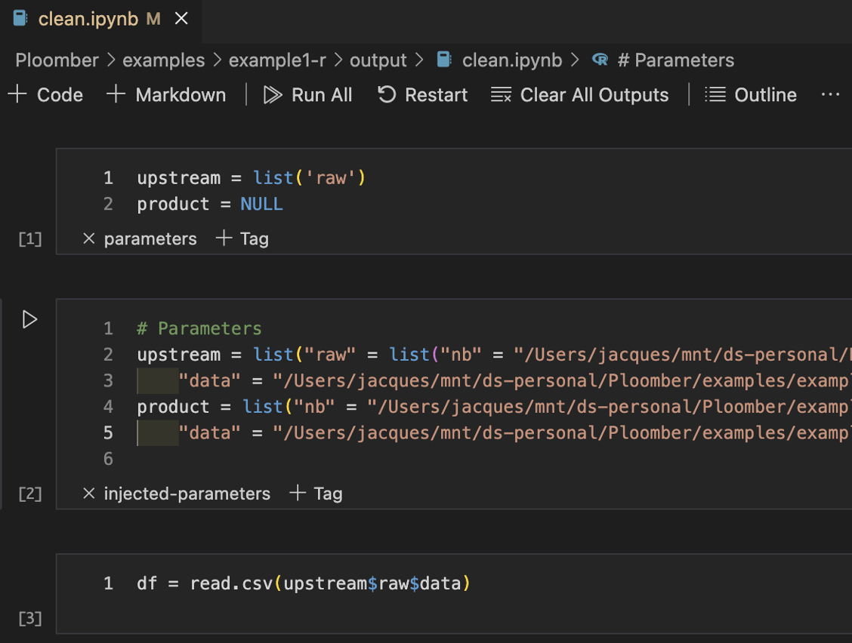
R
Python

Slide 18
Add Parameters
Import papermill as pm
pm.execute_notebook('input_nb.ipynb', 'outputs/20190402_run.ipynb',
{'region': 'ca', 'devices': ['phone', 'tablet']})
…
# Default values(Cell tagged as #parameters)
region = 'us' devices = ['pc']
date_since = datetime.now() - timedelta(days=30)
# Injected Parameters below #parameters cell
region = 'ca'
devices = ['phone', 'tablet']

Slide 19
Also Available as a CLI
# Same example as last slide
pm.execute_notebook('input_nb.ipynb', 'outputs/20190402_run.ipynb',
{'region': 'ca', 'devices': ['phone', 'tablet']})
…
# Bash version of that input
papermill input_nb.ipynb outputs/20190402_run.ipynb -p region ca -y '{"devices": ["phone", "tablet"]}'

Slide 20
Support for Cloud Targets
# S3
pm.execute_notebook( 's3://input/template/key/prefix/input_nb.ipynb', 's3://output/runs/20190402_run.ipynb')
# Azure
pm.execute_notebook( 'adl://input/template/key/prefix/input_nb.ipynb', 'abs://output/blobs/20190402_run.ipynb')
# GCS
pm.execute_notebook( 'gs://input/template/key/prefix/input_nb.ipynb', 'gs://output/cloud/20190402_run.ipynb')
# Extensible to any scheme

Slide 21
Changes to the notebook experience.
Adds notebook isolation
Immutable inputs
Immutable outputs
Parameterization of notebook runs
Configurable sourcing / sinking
and gives better control of notebook flows via library calls.

Slide 22
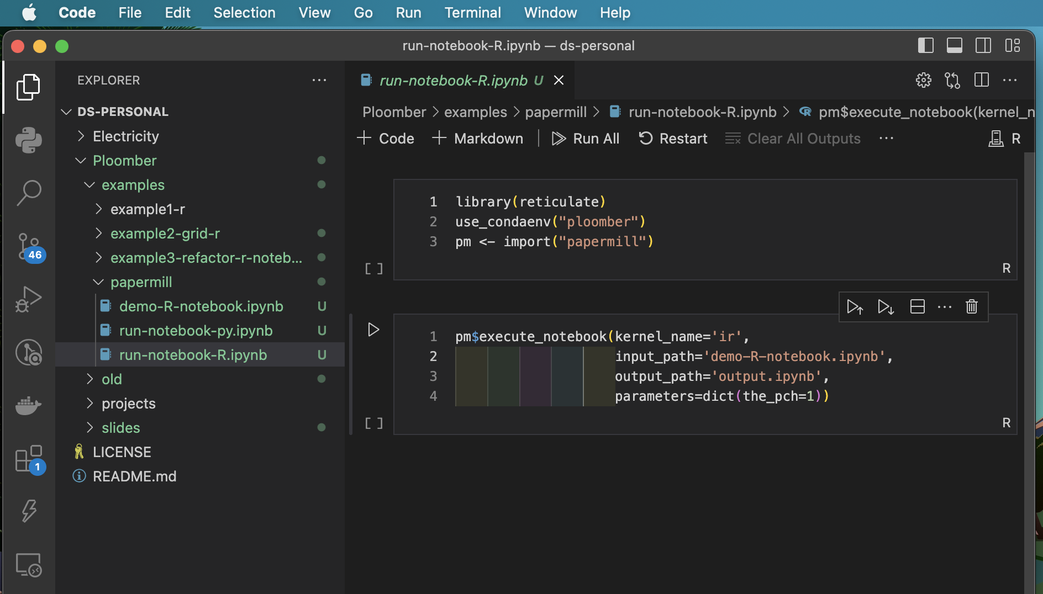
R Notebooks / Papermill Demo

Slide 23
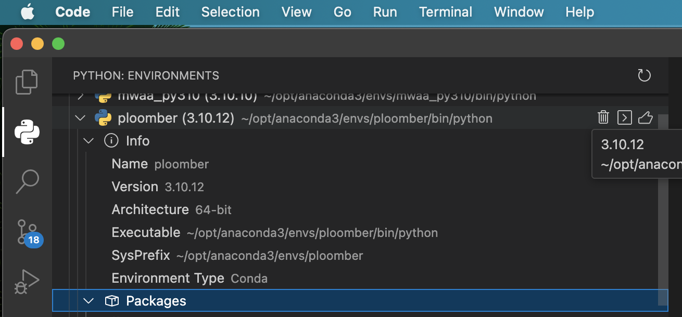
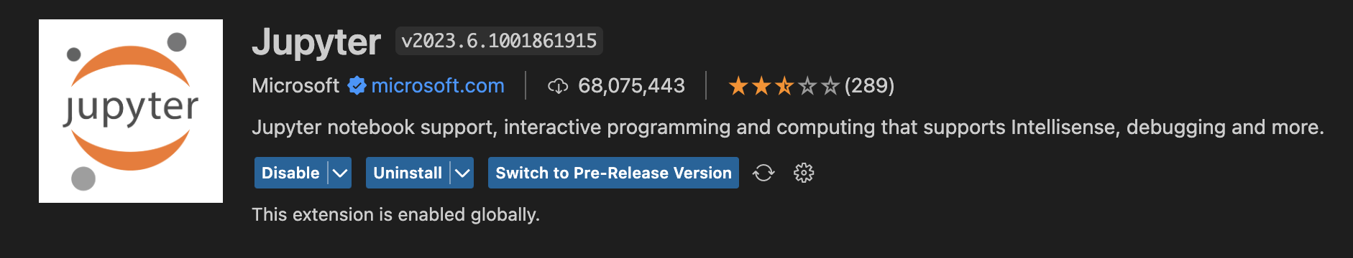
Environment Setup: Install Ploomber + enable Running R notebooks in VSCode
Create a python 3.10 environment
> pip3 install ploomber
Install the Jupyter extension in VsCode
R Run: >install.packages("IRkernel")
R Run: >IRkernel::installspec()
Create a new file with .ipynb file extension and open it
Select the R kernel to use.
Run r your R Code in it.

Slide 24

Ploomber

Slide 25

Poor man's solution
•
Code project in a (long) single ﬁle
Problem: Not maintainable
No clear boundaries among tasks
Leads to unwanted interactions We need reproducible and
maintainable projects
•
•

Slide 26

Why bother about maintainability?
Without a lot of structure, we forget what we’ve done in the past, we can’t read each others’ work, and we can’t test whether what we’ve done is correct.¹
— Patrick Ball
Image: https://unsplash.com/photos/r6mBXuHnxBk
¹ https://hrdag.org/2016/06/14/the-task-is-a-quantum-of-workflow/

Slide 27
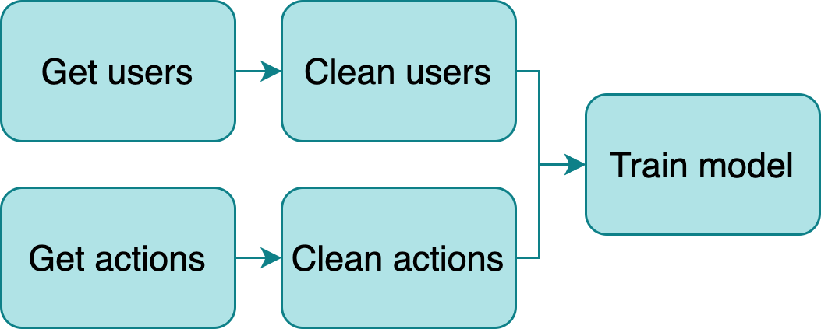
Build a data pipeline
•
Break down logic in small tasks
Outputs become inputs of downstream
tasks
New challenge: Manage structure
Multiple ﬁles
Route outputs
Orchestrate execution
•
•

Slide 28

Current approach: Workﬂow managers
•
Frameworks to develop pipelines (Make, Airﬂow, Luigi, etc)
Problems:
Learn a new tool
Write pipeline code
Adds unnecessary complexity
•
Image: https://unsplash.com/photos/l090uFWoPaI

Slide 29
Ploomber
Adheres to a convention over conﬁguration philosophy, to allows us to write pipelines with a focus on usability.
Three conventions:
Each task is a script
Scripts declare dependencies via an upstream variable
And outputs via a product variable

Slide 30
Main features
•
Python, R and SQL⁴ supported⁵
Parametrized pipelines with auto-generated CLI Testing (i.e., run data tests upon task execution) Debugger integration (pdb and ipdb)
•
•
•
Any database with a DBAPI 2.0 client or compatible with SQLAlchemy is supported
Languages that have Jupyter kernels are supported with a few limita9ons

Slide 31
Integration with Jupyter
•
Scripts open as notebooks³
(Temporary) cell injection
Ensures no hidden state by running
ploomber build
•
•
³ Thanks to jupytext! https://github.com/mwouts/jupytext

Slide 32
Environment Setup: Install Ploomber + enable Running R notebooks in VSCode
Create a python 3.10 environment
> pip3 install ploomber
Install the Jupyter extension in VsCode
R Run: >install.packages("IRkernel")
R Run: >IRkernel::installspec()
Create a new file with .ipynb file extension and open it
Select the R kernel to use.
Run r your R Code in it.

Slide 33
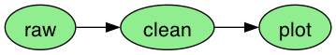
R workﬂow Example1
1. Input
3. Result
raw.R
clean.R
plot.Rmd
output/
raw.csv
raw.ipynb
clean.csv
clean.ipynb
plot.ipynb
2. Execute
ploomber build --entry-point .

Slide 34
R example 1: “pipeline.yaml”
tasks: # list of tasks
# use plain R scripts
- source: raw.R # write iris data to CSV
product:
# this is the executed version of your script
# you can review tables and charts here
nb: output/raw.ipynb # output notebook can also be html
data: output/raw.csv
- source: clean.R # clean iris data
product:
nb: output/clean.ipynb # output notebook can also be html
data: output/clean.csv # cleaned data
# R markdown files also supported
- source: plot.Rmd # plot iris data
product:
nb: output/plot.ipynb
# Quarto does not work yet :(
# - source: plot2.Qmd
# product:
# nb: output/quarto.ipynb

Slide 35
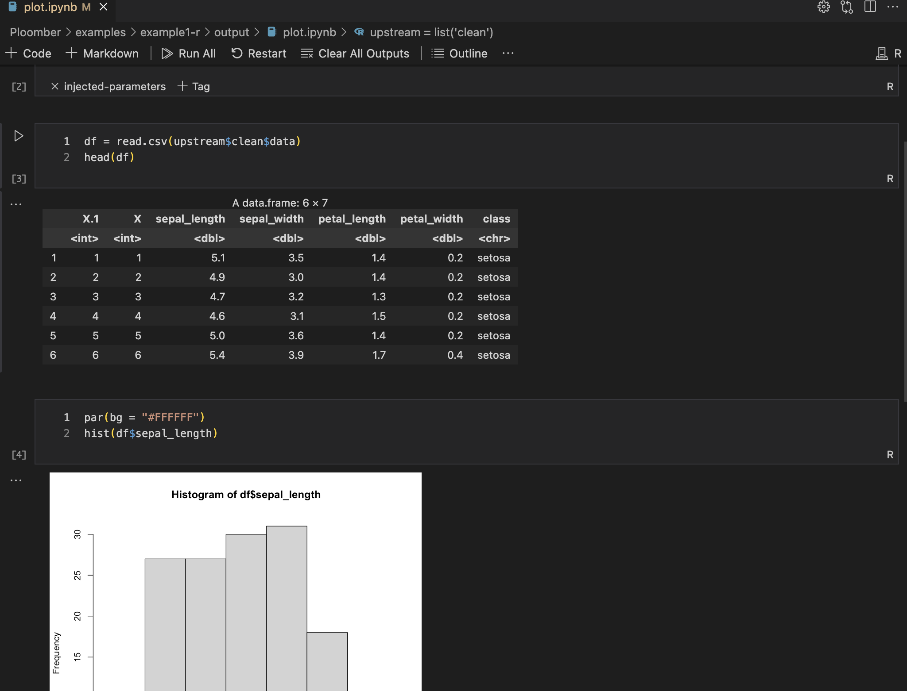
Tasks as notebooks
•
Tasks are converted to notebooks (.ipynb) before execution²
No need to write code to save tables or charts
Generate logs for each execution
•
•
² Thanks to papermill! h2ps://github.com/nteract/papermill

Slide 36
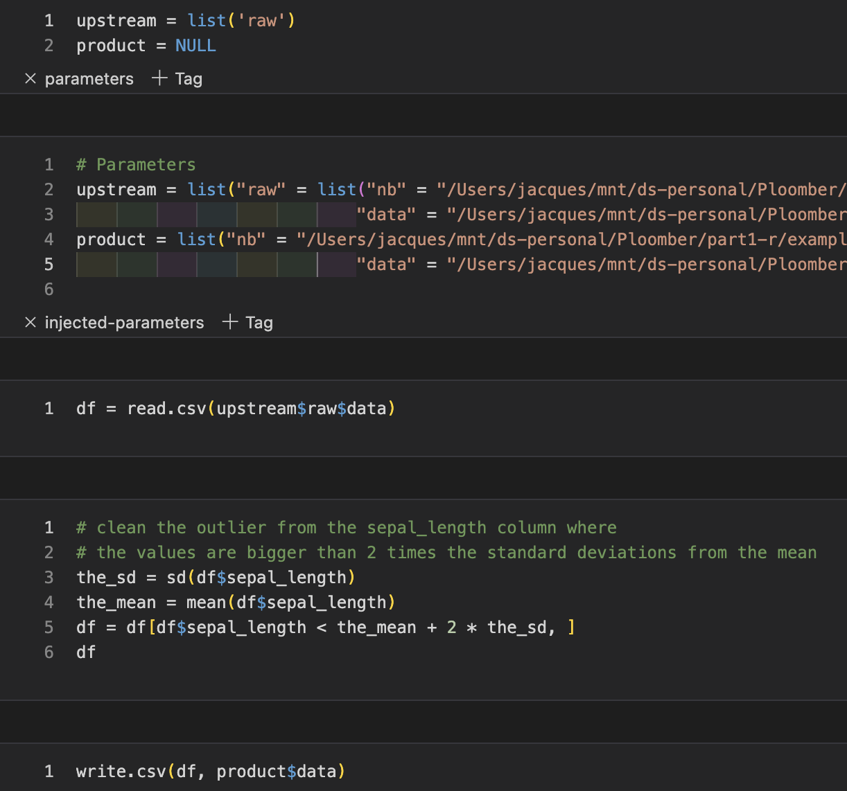
Tasks: R scripts/notebooks
clean.R
clean.ipynb
# + tags=["parameters"]
upstream = list('raw')
product = NULL
# -
df = read.csv(upstream$raw$data)
# clean the outliers from the sepal_length
# the values are bigger than 2 times the standard deviations from the mean
the_sd = sd(df$sepal_length)
the_mean = mean(df$sepal_length)
df = df[df$sepal_length < \
the_mean + 2 * the_sd, ]
df
write.csv(df, product$data)

Slide 37
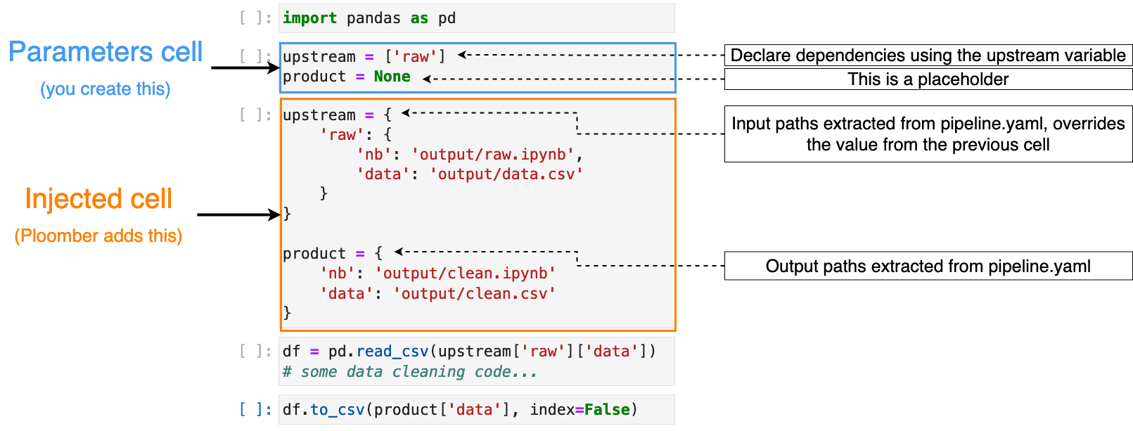
Cell injection concepts (Python)

Slide 38
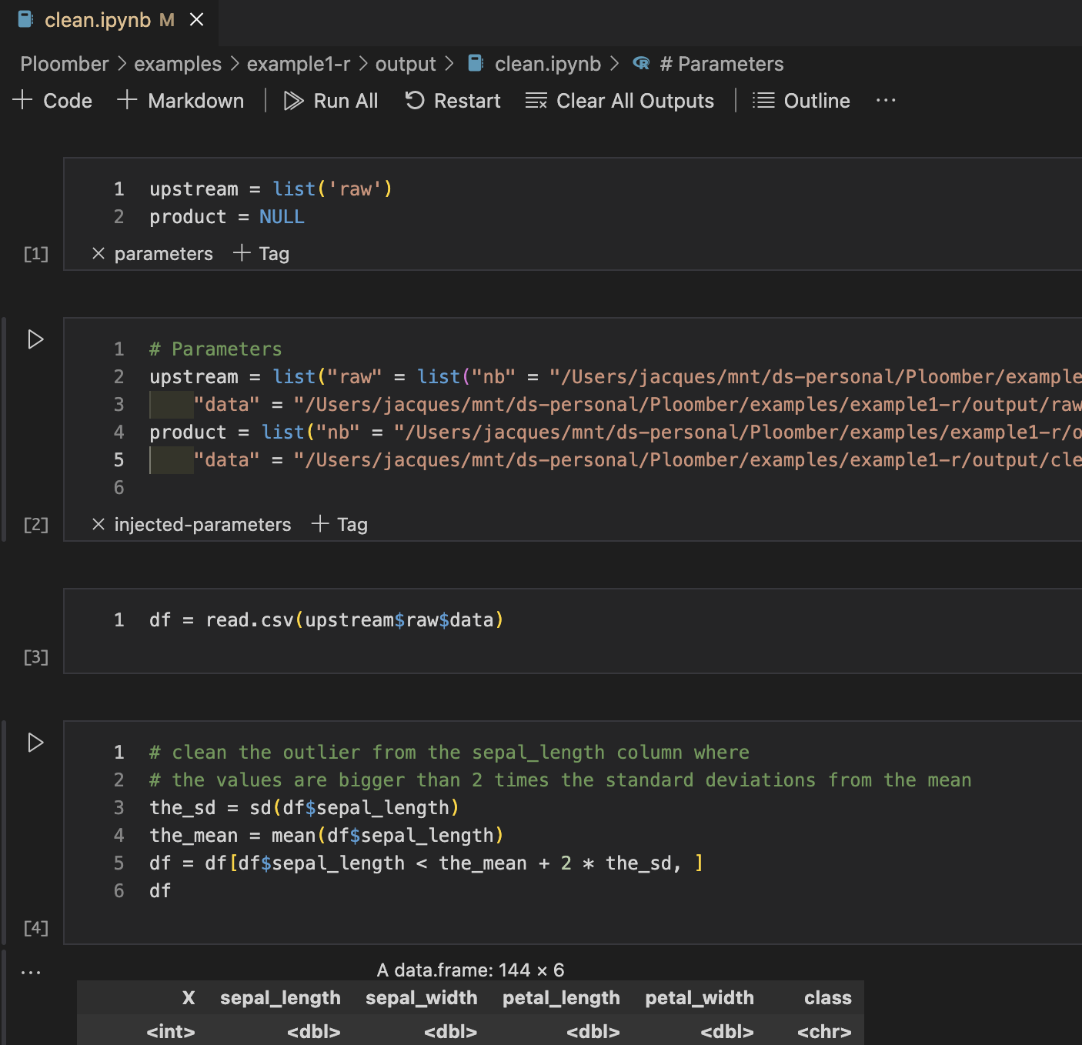
Cell injection: R notebook
See ‘parameters’ and ‘injected-parameters’ tags
Because the cleaning of the data are dependent on the raw data (upstream of ‘raw’ (raw.R) was requested, and upstream was replaced with the product output of raw.

Slide 39
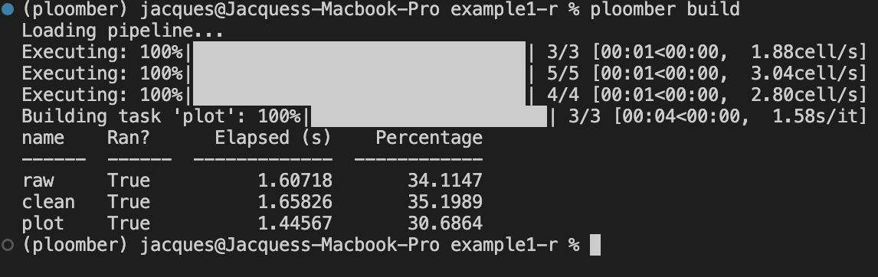
Build process
Extract upstream and product
Determine execution order using extracted upstream dependencies
Inject code. Replace the list of dependency names with a map of names to products
Execute the pipeline (skips up-to-date tasks)

Slide 40
Resources
Install: pip install ploomber
For updates/questons/feedback, follow me on LinkedLn:
https://docs.ploomber.io/en/latest/
https://docs.ploomber.io/en/latest/user-guide/r-support.html
Examples: github.com/ploomber/projects Website: ploomber.io
•
•
•
•

Slide 41
Thanks for watching!

